Slide 1
Predicting Illegal Substance Abuse
By Joe Gross and Luke Pomes

Slide 2

Purpose
Problems:
Long-term health issues (physical/mental)
Addiction and dependency on drugs
Overdosing and death
Other issues (Crime, Economic, and Legal issues)
Question we are trying to answer:
What feature values are predictive of illegal substance abuse within the past year

Slide 3
Related Work
"The Five Factor Model of personality and evaluation of drug consumption risk"
https://arxiv.org/abs/1506.06297
Original data collection and review
2015 study performing an exhaustive search to select the best subset of input features and ML classifier to distinguish users and non-users of various drugs
Classification quality was high, with sensitivity and specificity exceeding 70% for most tasks and surpassing 75% for substances such as cannabis, crack, ecstasy, legal highs, LSD, and volatile substance abuse, as evaluated using leave-one-out cross-validation.

Slide 4

Dataset Information
Contains records from 1,885 respondents with 12 attributes for respondents including:
Psychological Markers (neuroticism, extraversion, impulsivity)
Demographic attributes: (education, age, gender, country, ethnicity)
Respondents chose from a list of 18 substances and picked the ones they had within a given period of time
The period in which they took the drug consists of variables (never used, used over a decade ago, used in the last decade, used in the last year, used in the last month, used in the last week, and used in the last day)
Dataset Link: https://archive.ics.uci.edu/dataset/373/drug+consumption+quantified

Slide 5
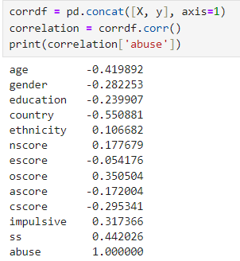
Approaches
Overview
Preprocessing
Clustering
Supervised Learning (Models)
Comparison
Key Findings
Correlations

Slide 6
Data Cleaning
Feature Engineering:
Used Attributes:
Cocaine
Ecstasy
Heroin
Ketamine
Legalh
LSD
Meth
Mushrooms
Dropped Attributes:
Alcohol
Cannabis
Chocolate
Nicotine
Semer (fictional drug as control value)
Values
No missing values
Reasons:
Kept illegal substances for sake of prediction
These substances are very common among the population and are legal in most places
Chocolate is unrelated and Semer does not add any value (it was fake)
Potential to change illegal substance abuse patterns if kept

Slide 7
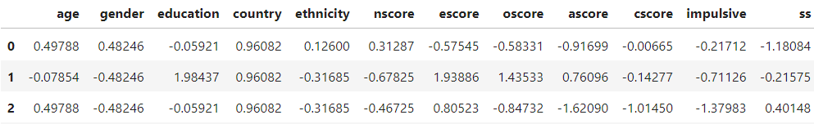
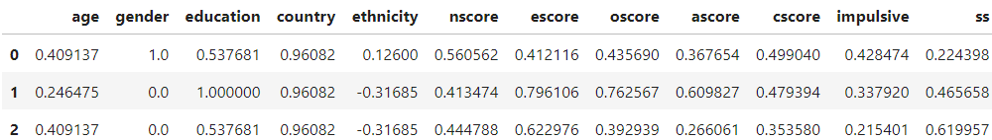
Scaling
Before
MinMax Scaler applied to dataset for fair distances in algorithms
Numeric Attributes affected:
'age', 'gender', 'education', 'nscore', 'escore', 'oscore', 'ascore', 'cscore', 'impulsive', 'ss'
After

Slide 8
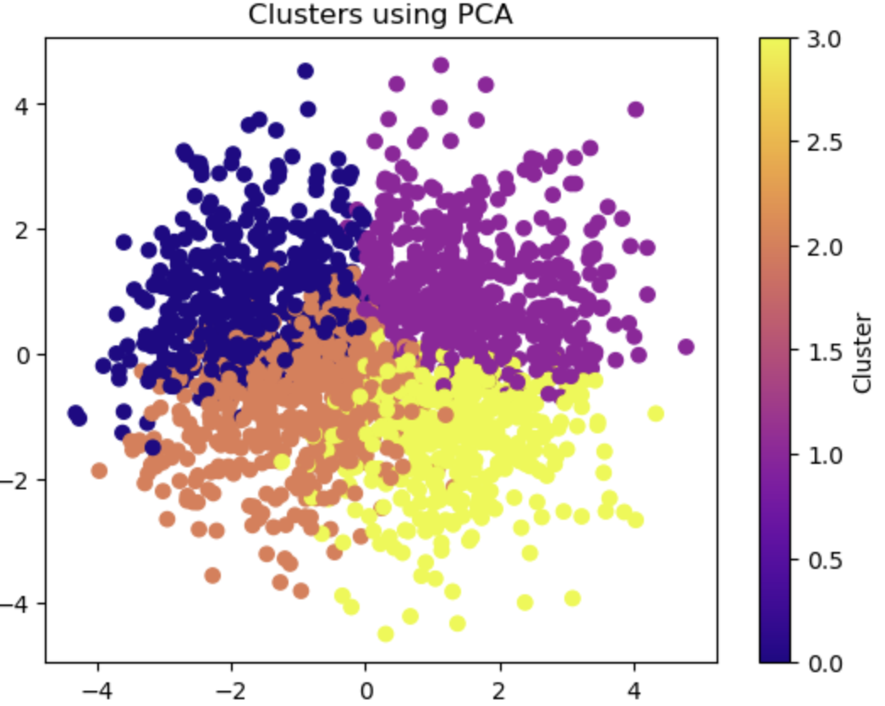
Clustering
Mean Drug Abuse:
Cluster 0: .237
Cluster 1: .844
Cluster 2: .307
Cluster 3: .931

Slide 9
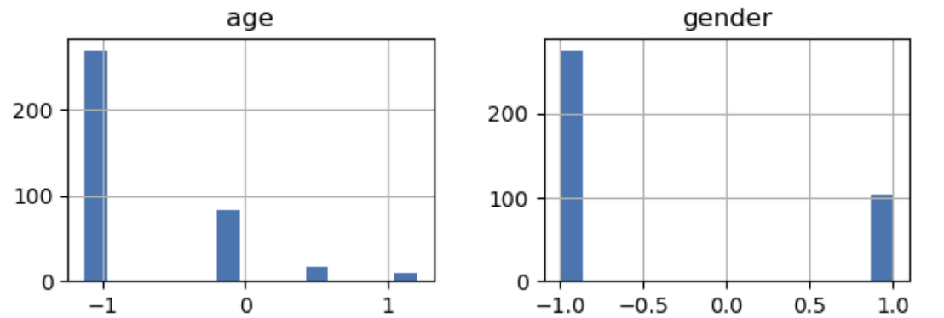
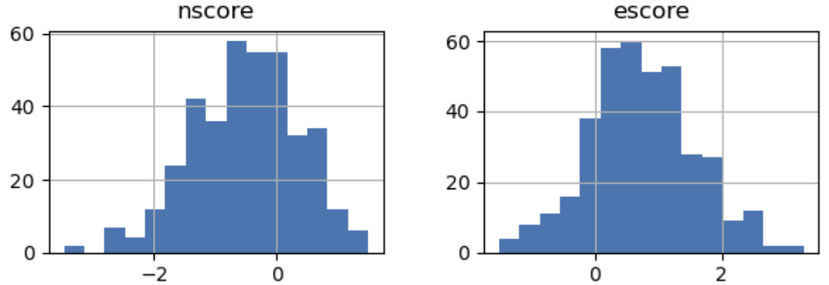
Cluster 3 Findings
Demographics
Age: -0.773 (18-24)
Gender: -0.450 (Mostly Male)
Education: -0.355 (Some college / no degree)
Score Mean Values
Nscore: -0.511 (30-31)
Escore: 0.736 (44-45)
Oscore: 0.843 (52)
Ascore: 0.069 (43-44)
Cscore: 0.049 (42-43)
Impulsive: 0.458 (11.46%)
SS: 0.828 (11.19%)

Slide 10
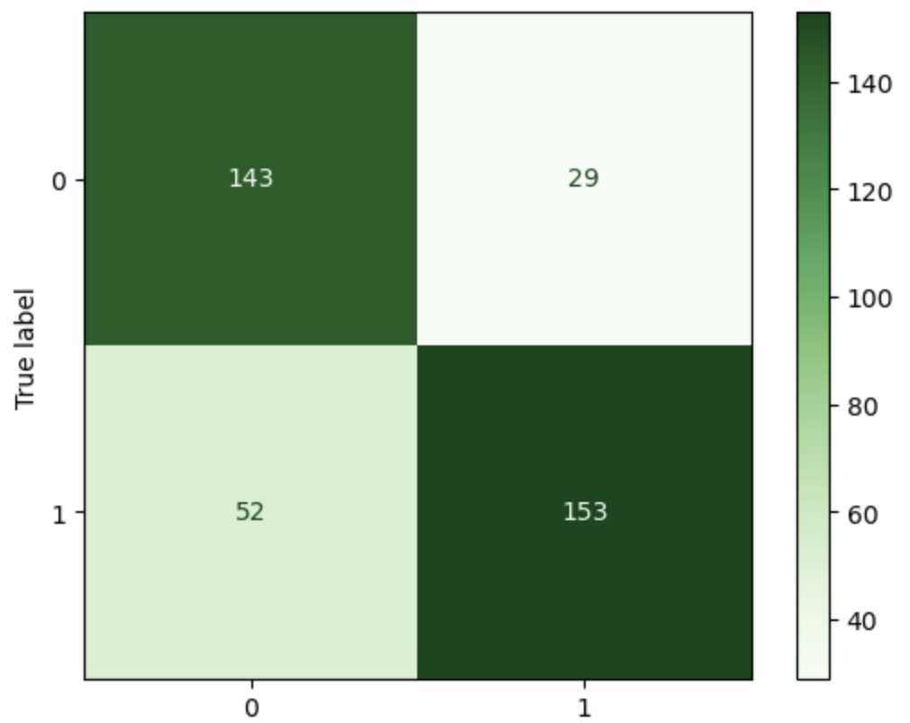
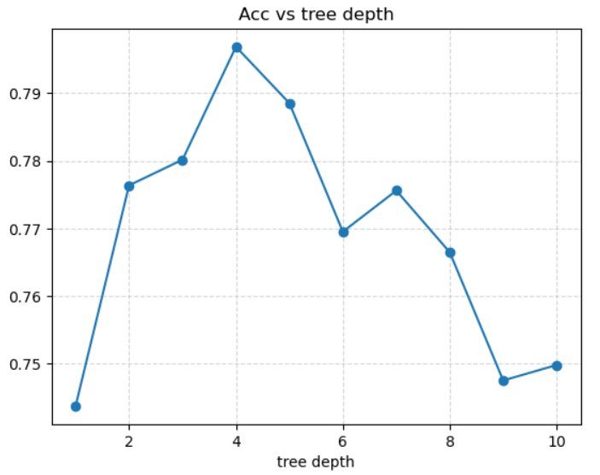

Decision Tree
Parameters:
Optimal Depth: 4
MAE 0.223
Accuracy
Mean: 78.51%
10 Fold CV Accuracies:
0.768, 0.762, 0.762, 0.762, 0.735, 0.808, 0.795, 0.775, 0.753, 0.813

Slide 11
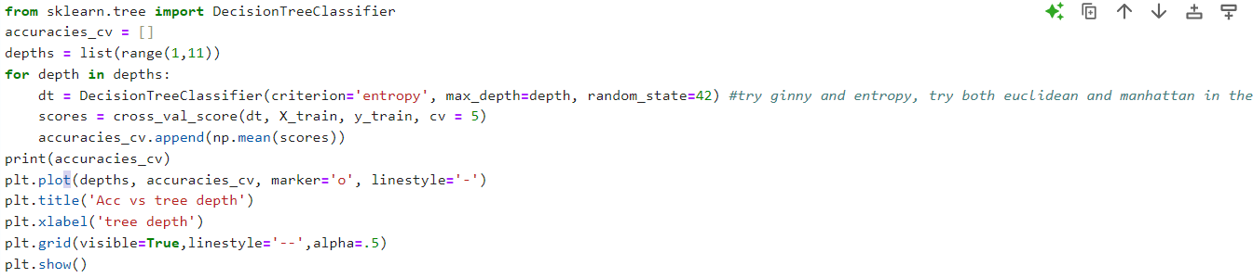
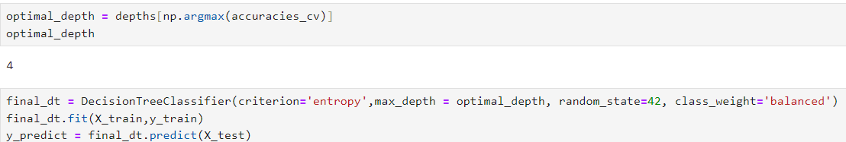
Decision Tree Code

Slide 12
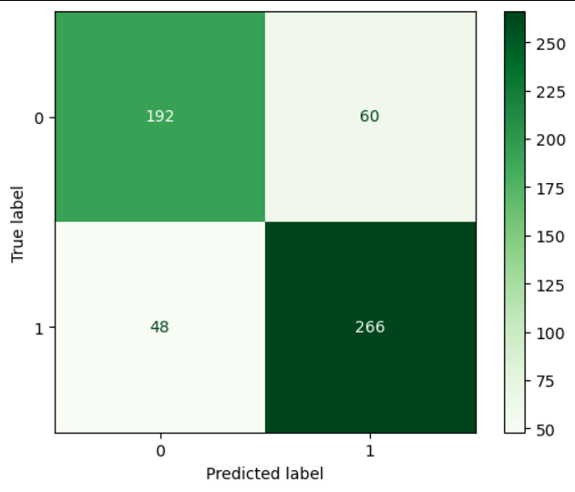
Random Forest
Parameters:
Optimal Depth: 90
Optimal Estimators: 16
Accuracy
Mean: 82.03%
10 Fold CV Accuracies:
0.833 0.795 0.795 0.75 0.826 0.818 0.856 0.818 0.811 0.870

Slide 13
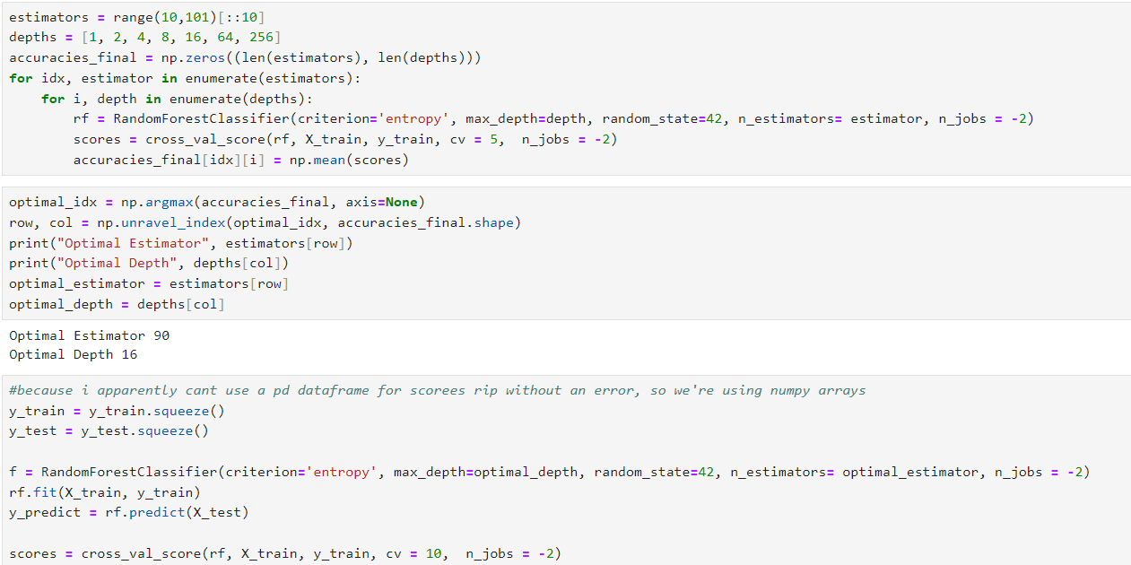
Random Forest Code

Slide 14
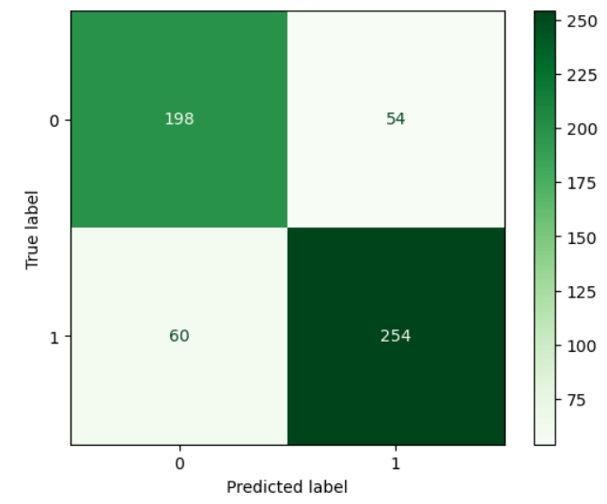
Gaussian NB
Accuracy
Mean: 81.9%
MAE
0.2014
Scores:
[0.82575758 0.79545455 0.81818182 0.76515152 0.84848485 0.79545455 0.81818182 0.81818182 0.81818182 0.88549618]

Slide 15
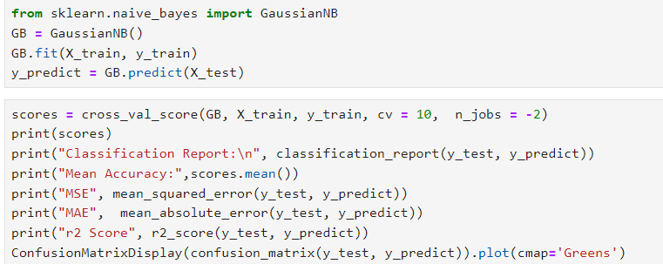
Gaussian Naïve Bayes Code w Eval

Slide 16
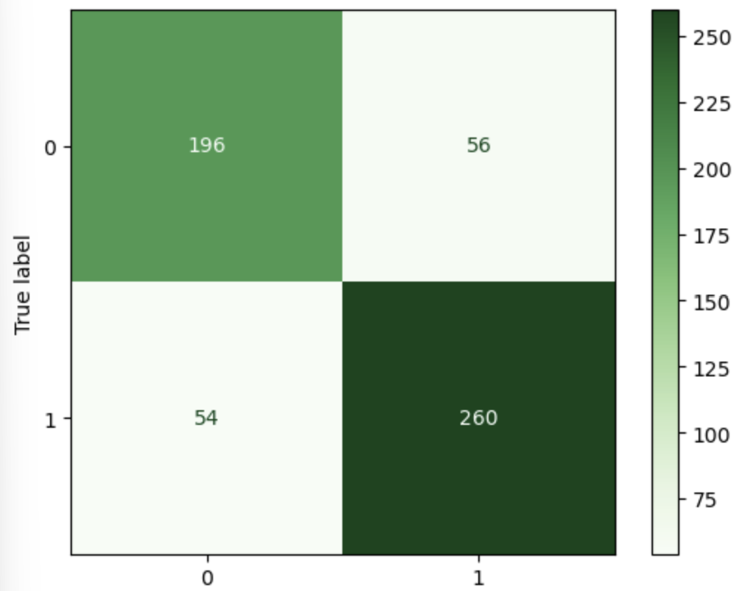
Logistic Regression
Parameters:
max_iter=12000, C=10**3
Threshold where increasing c and max_iter anymore doesnt do anything
MAE 0.194
Accuracy
Mean: 82.11%
10 Fold CV Accuracies:
0.833, 0.788, 0.826, 0.773, 0.841, 0.788, 0.826, 0.795, 0.848, 0.893

Slide 17
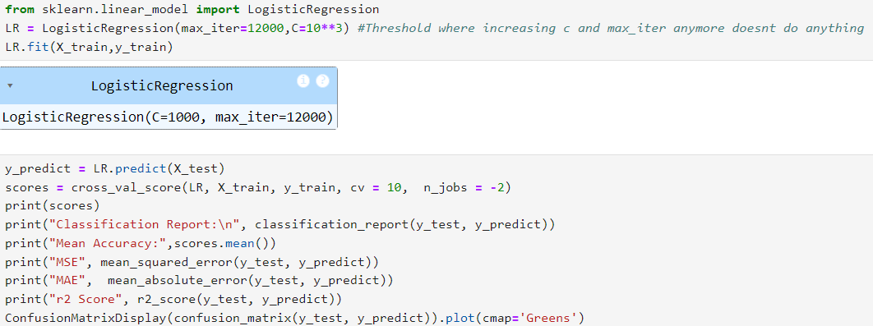
Logistic Regression and General Evaluation Code

Slide 18
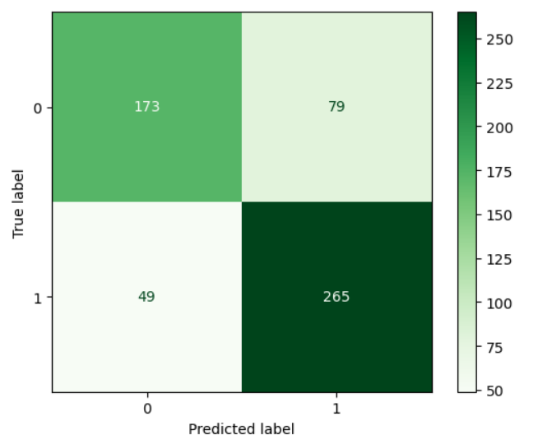
XGBoost
Post-Grid Search Parameters:
Max Depth 3, n_estimators = 69
Accuracy
Mean: 80.1%
MAE
0.226

Slide 19
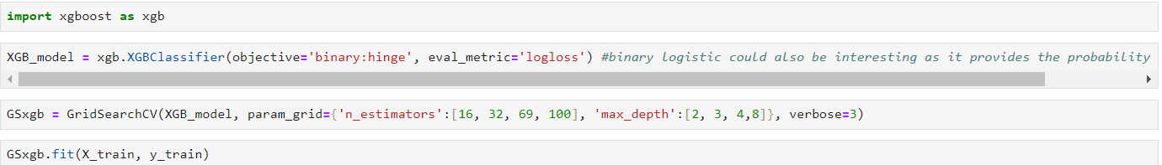
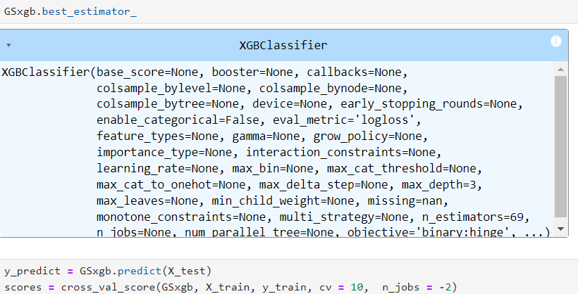
Extreme Gradient Boosting Code

Slide 20
SVM
Post-Grid Search Parameters:
C = 100, Gamma = 0.001
Accuracy
Mean: 82.04%
MAE
0.203

Slide 21
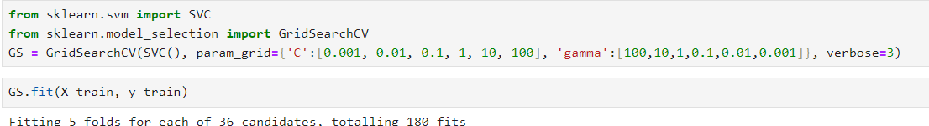

Support Vector Machine Classification Code

Slide 22
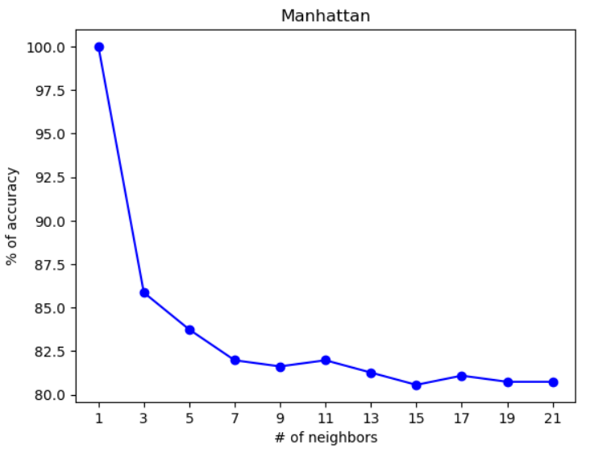
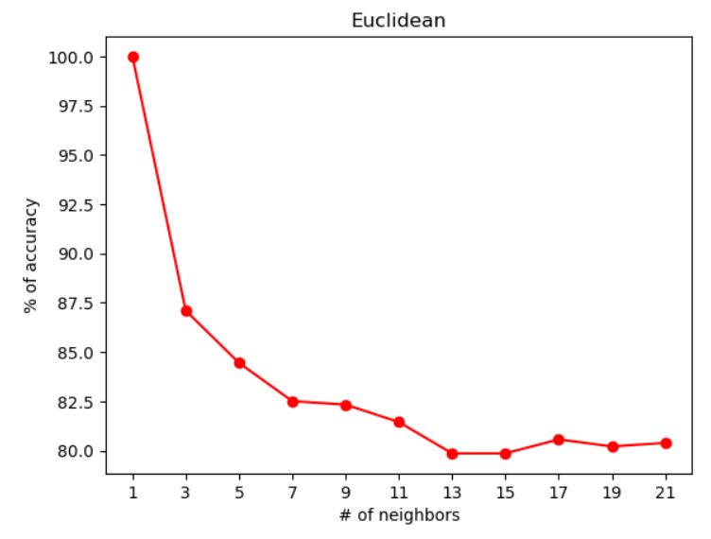
KNN

Slide 23
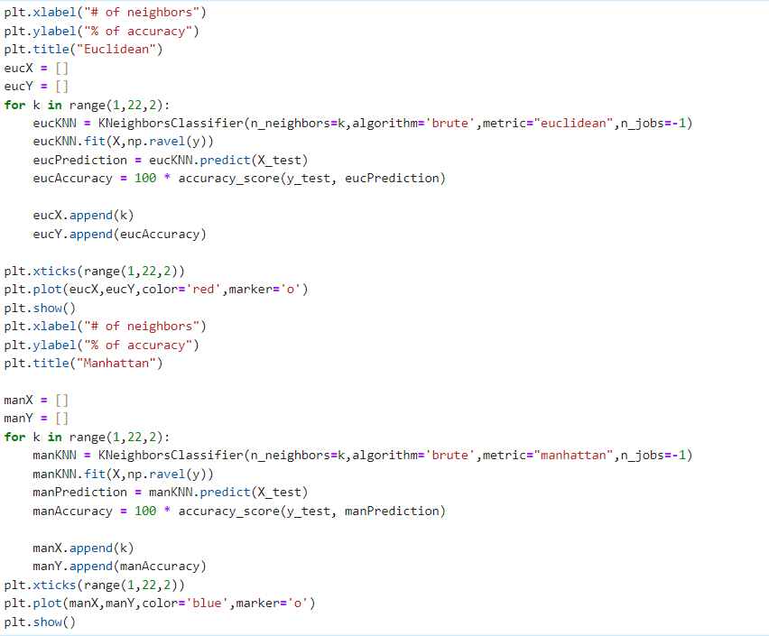
K-Nearest Neighbors Code

Slide 24

Comparison of models
Model | Decision Tree | Random Forest | Logistic Regression | Naive Bayes | SVM
Mean Accuracy | 0.774 | 0.82035 | 0.8211 | 0.819 | 0.82036
MAE | 0.226 | 0.2067 | 0.194 | 0.2014 | 0.203
R2 | 0.084 | 0.163 | 0.213 | 0.184 | 0.177
Note R^2 score may not be particularly useful considering the likely lack of a linear relationship between the independent features and target class

Slide 25
Key Findings
Project Findings
Score values are great indicators in telling what someone behaves like. Cluster 3's values can be focused to be associated with drug abuse
Features such as age and education can be used to target specific groups who abuse illegal drugs more often
Logistic Regression very slightly outperformed other algorithms on the dataset, this gave us a high accuracy of the data
Limitations
Possibility data collection took place a while ago
Potential bias in the sampling
Specific countries used in sampling

Slide 26
Conclusion
Takeaways
Found strong ability to predict potential for drug abuse given these input features
Impulsivity and Sensation attributes with strongest correlation with abuse
What we could have done differently
Given the time a hybrid or aggregate model could have perhaps improved results
Used Weka to save time hardcoding everything
Run Grid Search for Random Forest and DT parameters given that it would have required a GPU library like tensorflow or Cuml

